Slide 1




INTRODUCTION
What Is This Project?
Bridging Academia & Industry
This project finds the gap between what universities teach and what companies need today. It looks at university course outlines and real job listings, then uses AI to compare them.
University Course Content
compared by AI
Based on the research paper
“The race for AI skills as an obstacle course” — Ifenthaler et al. (2025), Project Leadership and Society.
Real Job Requirements
AI Education Gap Mapper
2

Slide 2




PROBLEM STATEMENT
The Problem We Are Solving
Too Much Theory
Skills Change Fast
No Simple Way to Check
University courses focus on theory and often miss the practical tools companies actually use.
Industry skills change quickly, but course content is updated very slowly.
There is no easy system to check if a course still matches what employers want.
This gap makes it harder for graduates to get jobs, because they may not have the skills employers are asking for.
AI Education Gap Mapper
3

Slide 3

PROGRAMMING FOR AI — RESEARCH PROJECT
AI Education Gap Mapper
A simple AI system that compares what universities teach with what the job market needs.
TEAM MEMBERS
Irbaz
SP24-BSAI-0007
Najam
SP24-BSAI-0008
Mubeen
SP24-BSAI-0021
Ali Zubair
SP24-BSAI-0003
Course: Programming For AI – AM Instructor: Hamydah Raees
Department of Artificial Intelligence • Mohammad Ali Jinnah University

Slide 4


OBJECTIVES
Project Objectives
Find Skill Gaps
Check Real Job Data
Compare course content with job posts to find missing skills.
Test results against real listings from sites like LinkedIn and Coursera.
Suggest Improvements
Use AI / ML
Recommend new topics or tools that courses should add.
Use machine learning to compare and match skills automatically.
AI Education Gap Mapper
4

Slide 5




SYSTEM OVERVIEW
How the System Works
INPUT
PROCESSING
OUTPUT
Course Outlines + Job Posts
AI Text Analysis
Gap Report
Collects university syllabi and real job descriptions.
Compares the text to find matching and missing skills.
Shows a clear report of which skills are missing.
AI Education Gap Mapper
5

Slide 6
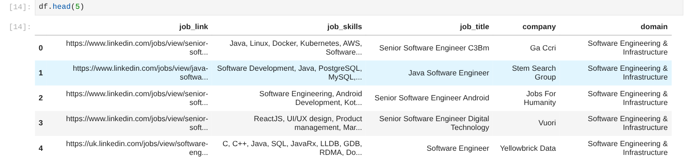
DATASET OF FIRST 5 ROWS

Slide 7
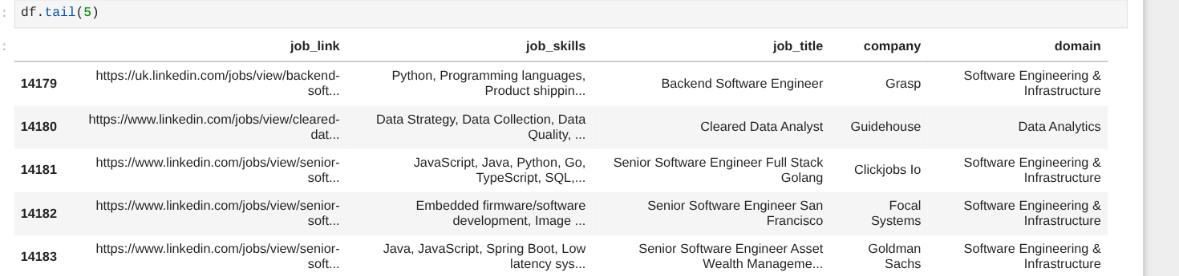
DATASET OF Last 5 ROWS

Slide 8



METHODOLOGY
How We Built It
01
02
03
04
05
Collect Data
Clean Data
Find Skills
Compare
Show Results
Gather job listings and university course outlines.
Clean and organize the text so it is ready to use.
Pull out key skills using text analysis and keyword matching.
Compare university skills with job-required skills.
Display missing skills in simple charts and reports.
AI Education Gap Mapper
6

Slide 9





TOOLS & TECHNOLOGIES
Tools We Used
Core Stack
Text Processing
Charts & Visuals
Python, Jupyter, Scikit-learn, Pandas, and NumPy for the main logic.
NLTK and spaCy to clean and prepare the text data.
Matplotlib and Seaborn to draw clear, simple charts.
AI Education Gap Mapper
7

Slide 10
ARCHITECTURE
System Architecture
INPUT LAYER
Course outlines and syllabi
Live job listings from job sites
▼
PROCESSING LAYER
Cleans and matches text
Runs models: Decision Tree, Naive Bayes, Random Forest
▼
OUTPUT LAYER
A full skill-gap report
Easy-to-read charts
AI Education Gap Mapper
8

Slide 11
RESULTS & ANALYSIS
What We Found
Theory Match
85% Match
Practical Tools
60% Missing
Deployment Tools
45% Match
Soft Skills
30% Match
In short: courses match well on theory, but fall short on practical, hands-on tools that employers expect.
AI Education Gap Mapper
9

Slide 12
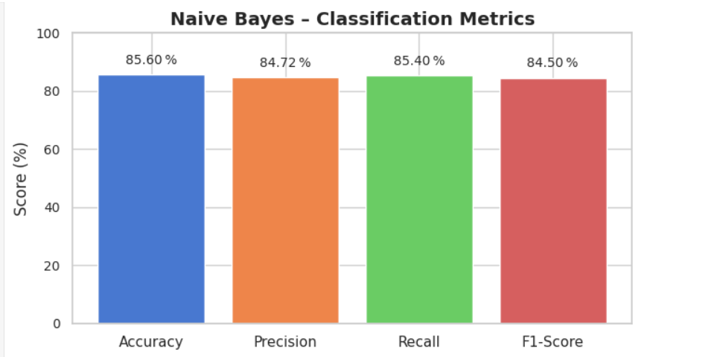
EVALUATION METRICS GRAPH OF RESEARCH PAPER SOLUTION

Slide 13
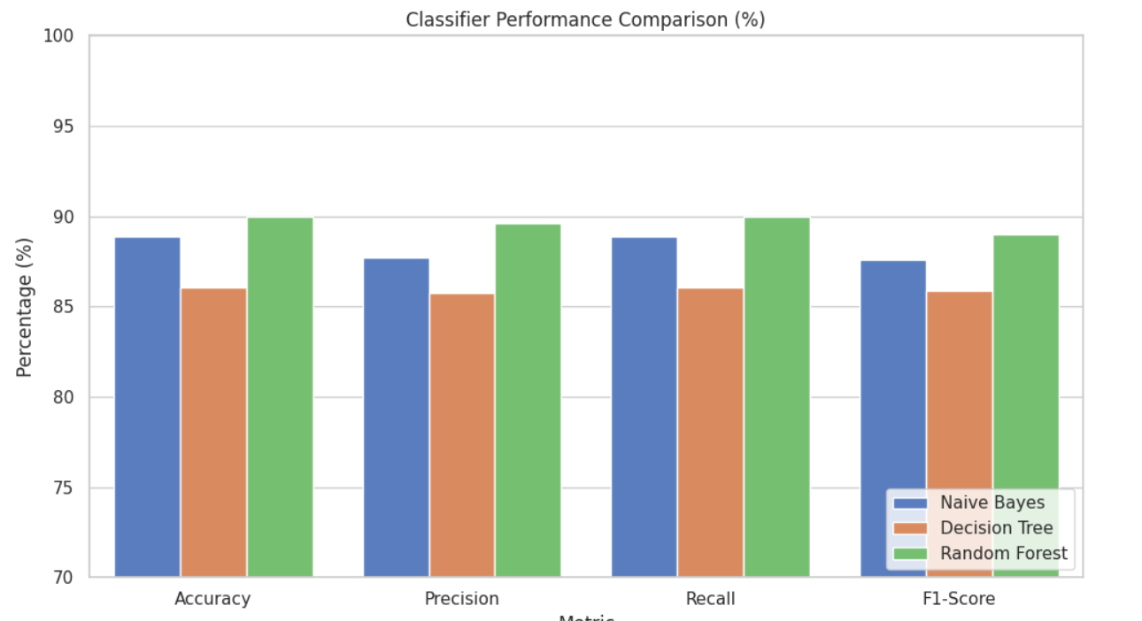
EVALUATION METRICS GRAPH OF OUR SOLUTION

Slide 14
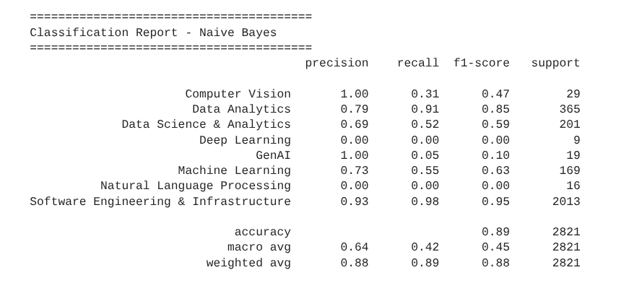
CLASSIFICATION REPORT OF OUR SOLUTION

Slide 15
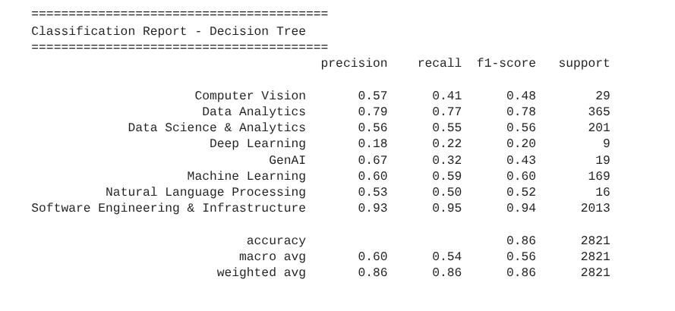
CLASSIFICATION REPORT OF OUR SOLUTION

Slide 16
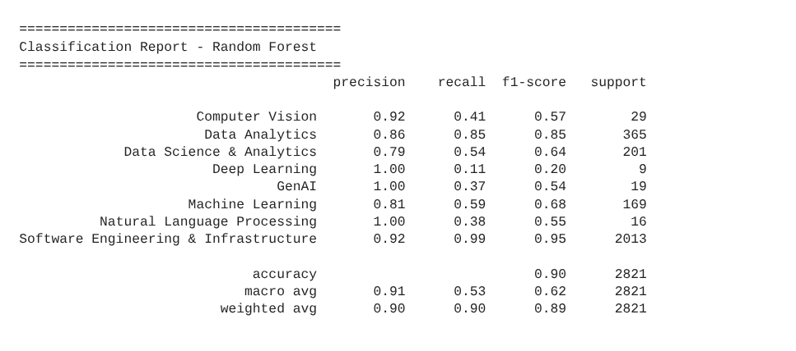
CLASSIFICATION REPORT OF OUR SOLUTION

Slide 17
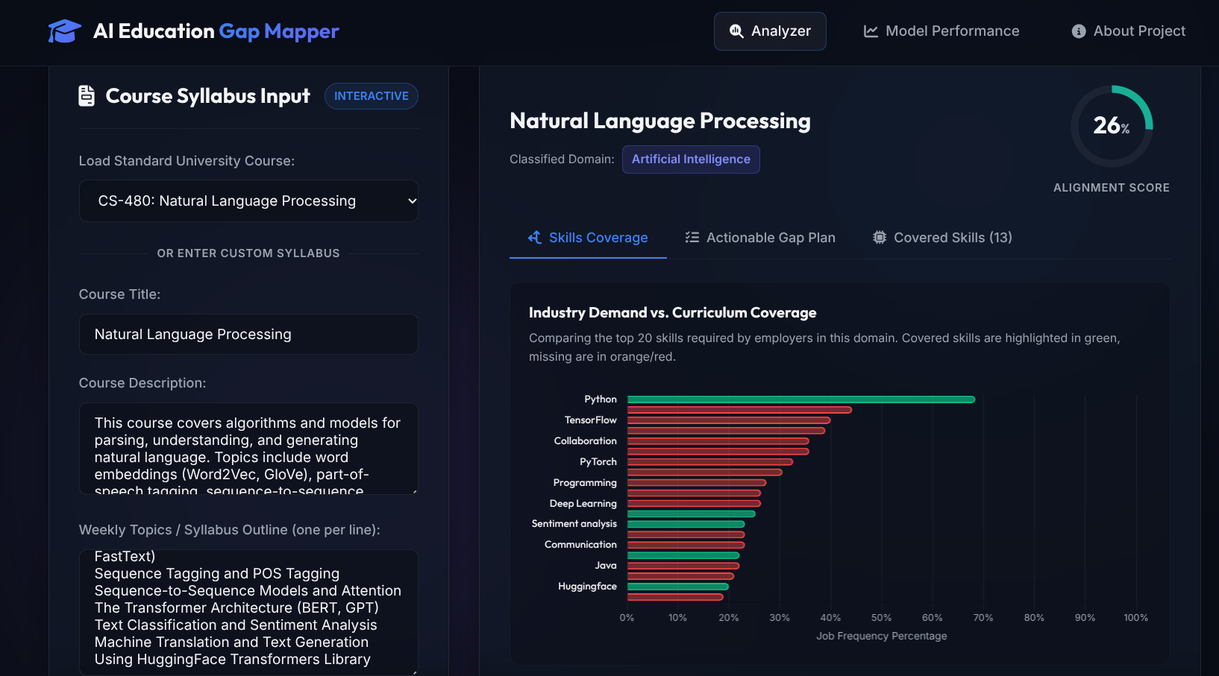
RESULTS:

Slide 18
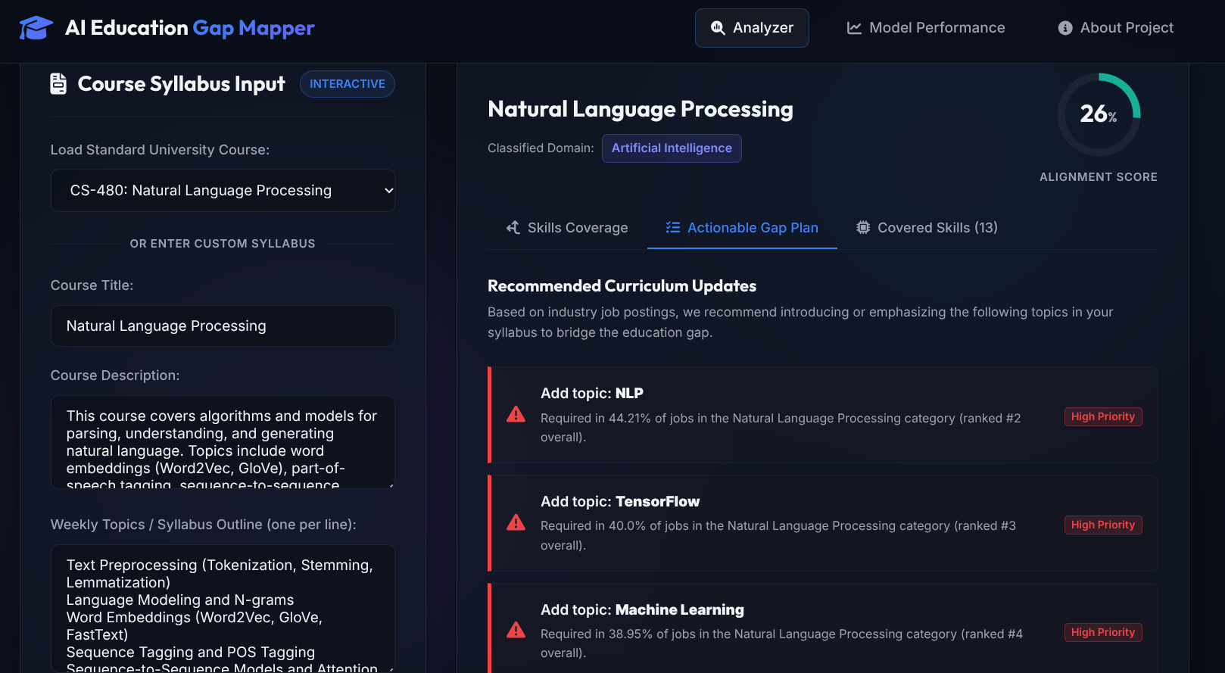
RESULTS:

Slide 19
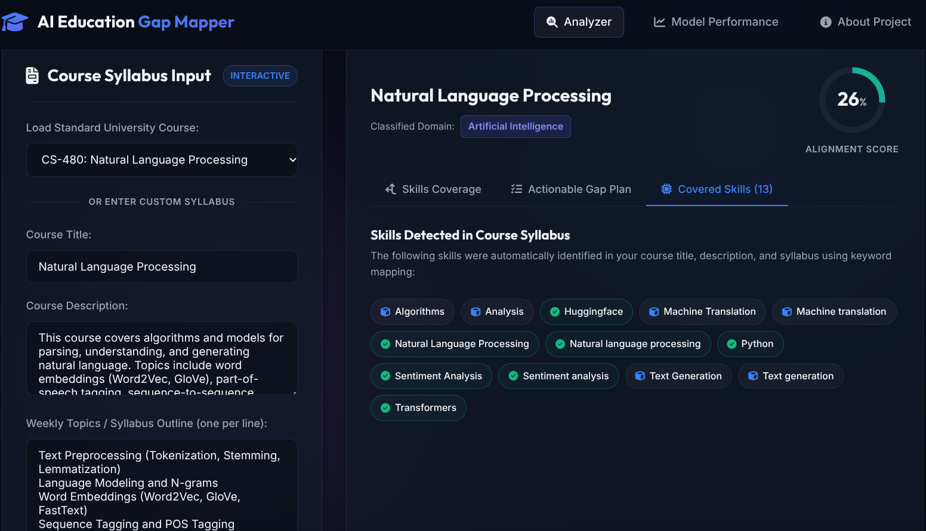
RESULTS:

Slide 20

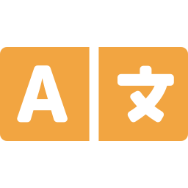
CHALLENGES
Challenges We Faced
Messy Job Data
Different Words, Same Meaning
Job posts are unorganized, so they need a lot of cleaning before they can be used.
Different sources use different words for the same skill, like “ML” vs “Machine Learning.”
AI Education Gap Mapper
10

Slide 21


FUTURE WORK
What's Next
Smarter Models
Live Job Data
Simple Web App
Use newer AI models, like BERT, to better understand text.
Automatically collect new job listings to keep data up to date.
Build an easy website where students can check their own skill gaps.
AI Education Gap Mapper
11

Slide 22


CONCLUSION
Conclusion
This system finds the gap between what universities teach and what the job market needs — using simple AI and text analysis methods to make curriculum review easier and faster.
KEY DELIVERABLES
Project Proposal
Final Report
Presentation Slides
Source Code
GitHub Repository
Project Repo: github.com/veriables/skills_gap_analysis Reference: Ifenthaler et al. (2025), Project Leadership & Society
12

